Slide 1

Research Methodology
Structure & Components of Report
Dr. Arti Arya
Department of Computer Science and Engineering

Slide 2

Research Methodology
Structure & Components of Report
Dr. Arti Arya
Department of Computer Science and Engineering

Slide 3
Research Methodology
Disclaimer
These slides are prepared from the prescribed text book and other reliable resources from the Internet.
The images are imported from various sites and videos are imported from youtube.com

Slide 4

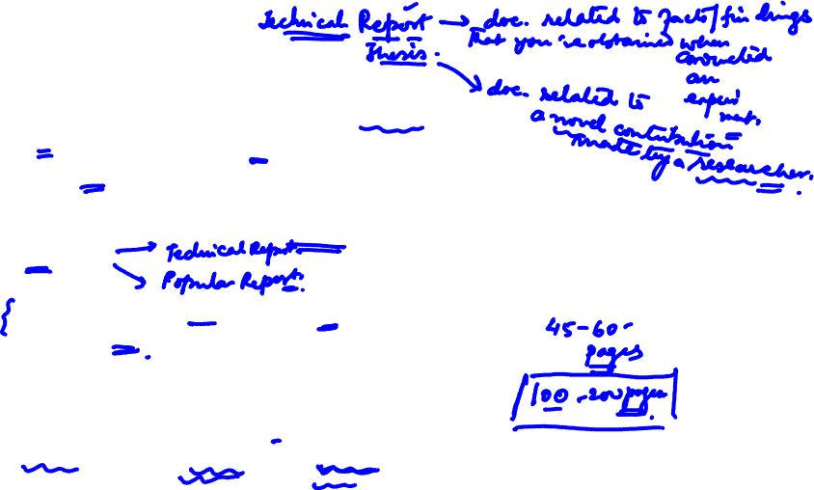
Research Methodology
Research Report
A Report is a written document on a particular topic, which conveys information and ideas and may also make recommendations.
Reports often form the basis of crucial decision making.
Inaccurate, incomplete and poorly written reports will fail to achieve their purpose and reflect on the decision, which will ultimately be made.
This will also be the case if the report is excessively long, jargonistic or structure less.

Slide 5

Research Methodology
Research Report
A research report is considered a major component of any research study as the research remains incomplete till the report has been presented or written.
Writing a report is the last step in a research study and requires a set of skills somewhat different from those called for in actually conducting a research.

Slide 6


Research Methodology
Good Reports- Some Rules
All points in the report should be clear to the intended reader.
The report should be concise with information kept to a necessary minimum and arranged logically under headings.
All information should be correct and supported by evidence.
All relevant material should be included in a complete report.

Slide 7

Research Methodology
Purpose of Research Report
Why am I writing this report? Do I want to inform/ explain/ persuade or indeed all of these.
Who is going to read this report? Managers/ academicians/ researchers what do they know already? What do they need to know? Do any of them have certain attitudes or prejudices?

Slide 8

Research Methodology
Purpose of Research Report
What resources do we have? Do I have access to computer? Do I have enough time? Can any of my colleagues help?
Think about the content of your report- what am I going to put in it? What are my main themes? How much should be text and how much should be illustrations?

Slide 9

Research Methodology
Report Writing
Video Link: https://www.youtube.com/watch?v=1hNC_me9aVM

Slide 10

Research Methodology
Steps in writing report
Research reports are the product of slow, painstaking, accurate inductive work. The usual steps involved in writing report are:
Logical analysis of subject matter: It is the first step which is primarily concerned with the development of a subject. There are two ways to develop a subject:
Logically: The logical development is made on the basis of mental connections and associations between the one thing and another by means of analysis. Logical treatment often consists in developing the material from the simple possible to the most complex structures.
Chronologically: Chronological development is based on a connection or sequence in time or occurrence. The directions for doing or making something usually follow the chronological order.

Slide 11

Research Methodology
Steps in writing report
2. Preparation of final outline: It is the next step in writing the research report “Outlines are the framework upon which long written works are constructed.
Having decided the plan of his subject matter, the researcher should prepare an outline of his report, by indicating the chapters to be developed, the chapter content in terms of headings, sub-headings questions to be answered etc.
They are an aid to the logical organisation of the material and a reminder of the points to be stressed in the report.

Slide 12

Research Methodology
Steps in writing report
3. Preparation of the rough draft: This follows the logical analysis of the subject and the preparation of the final outline.
Once the outline is ready, it is given a shape through the preparation of rough draft.
At this stage the researcher need not impose any restrictions with regard to the style, language, presentation, length of report etc.
He will write down the procedure adopted by him in collecting the material for his study along with various limitations faced by him, the technique of analysis adopted by him, the broad findings and generalizations and the various suggestions he wants to offer regarding the problem concerned.

Slide 13

Research Methodology
Steps in writing report
4. Rewriting and polishing of the rough draft: This step happens to be most difficult part of all formal writing. Usually this step requires more time than the writing of the rough draft.
In this stage, the rough draft is edited, polished and brought to actual size, by eliminating all that is unwanted in the rough draft.
While rewriting and polishing, one should check the report for weaknesses in logical development or presentation.

Slide 14

Research Methodology
Steps in writing report
4. Rewriting and polishing of the rough draft:
In addition the researcher should give due attention to the fact that in his rough draft he has been consistent or not.
He should check the mechanics of writing—grammar, spelling and usage.

Slide 15

Research Methodology
Steps in writing report
5. Preparation of the final bibliography: Next in order comes the task of the preparation of the final bibliography.
The bibliography, which is generally appended to the research report, is a list of research papers, books, sites etc in some way pertinent to the research which has been done. It should contain all those works which the researcher has consulted.
The bibliography should be arranged alphabetically.

Slide 16
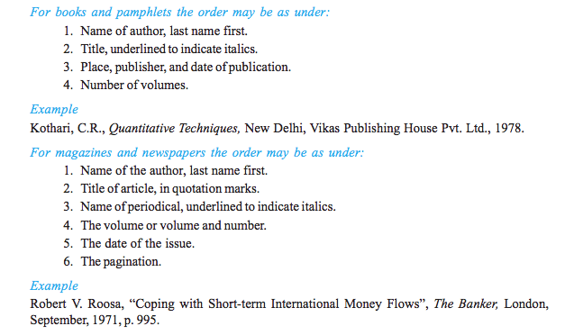
Research Methodology
Steps in writing report
5. Preparation of the final bibliography: (Contd..)

Slide 17

Research Methodology
Steps in writing report
6. Preparation of the final draft: This constitutes the last step. The final draft should be written in a concise and objective style and in simple language, avoiding vague expressions such as “it seems”, “there may be”, and the like ones.
Should avoid contradictory statements, delete questionable and debatable conclusions.
Moreover, the conclusions should emerge from research study. They must be original and not borrowed.
It must be remembered that every report should be an attempt to solve some intellectual problem and must contribute to the solution of a problem and must add to the knowledge of both the researcher and the reader.

Slide 18

Research Methodology
Precautions for writing a research report
1. The length of the report should be decided in accordance with the purpose.
2. The report should be interesting to read and must not be loaded.
3. The tables and figures should be added for further clarity.
4. The report should be free from any type of mistakes.
5. Materials used as reference should be acknowledged and the details should be given through either foot notes or end notes.

Slide 19

Research Methodology
Precautions for writing a research report
6. The report should be logically structured.
7. Repetition should be avoided.
8. Appendices, bibliography and index should be integral part of the research report.
9. The technical tools applied in the process of analysis should all be explained in details through the methodology adopted for the study.
10. The physical appearance of the report should be attractive, neat and clean.

Slide 20

Research Methodology
Structure of Report
Anybody, who is reading the research report, must necessarily be conveyed enough about the study so that he can place it in its general scientific context, judge the adequacy of its methods and thus form an opinion of how seriously the findings are to be taken.
(A) Preliminary Pages
In its preliminary pages the report should carry a title and date, followed by acknowledgements in the form of ‘Preface’ or ‘Foreword’.

Slide 21
Research Methodology
Structure of Report
Then there should be a
Table of Contents followed by
list of tables and illustrations
so that the decision-maker or anybody interested in reading the report can easily locate the required information in the report.

Slide 22

Research Methodology
Structure of Report
(B) Main Text: The main text provides the complete outline of the research report along with all details.
Title of the research study is repeated at the top of the first page of the main text and then follows the other details on pages numbered consecutively, beginning with the second page.
Each main section of the report should begin on a new page. The main text of the report should have the following sections:
i) Introduction
(ii) Statement of findings and recommendations
(iii) The results
(iv) The implications drawn from the results
(v) The summary.

Slide 23

Research Methodology
Structure of Report
(C) End Matter
At the end of the report, appendices should be enlisted in respect of all technical data such as questionnaires, sample information, mathematical derivations and the like ones. Bibliography of sources consulted should also be given.
Index (an alphabetical listing of names, places and topics along with the numbers of the pages in a book or report on which they are mentioned or discussed) should invariably be given at the end of the report.

Slide 24
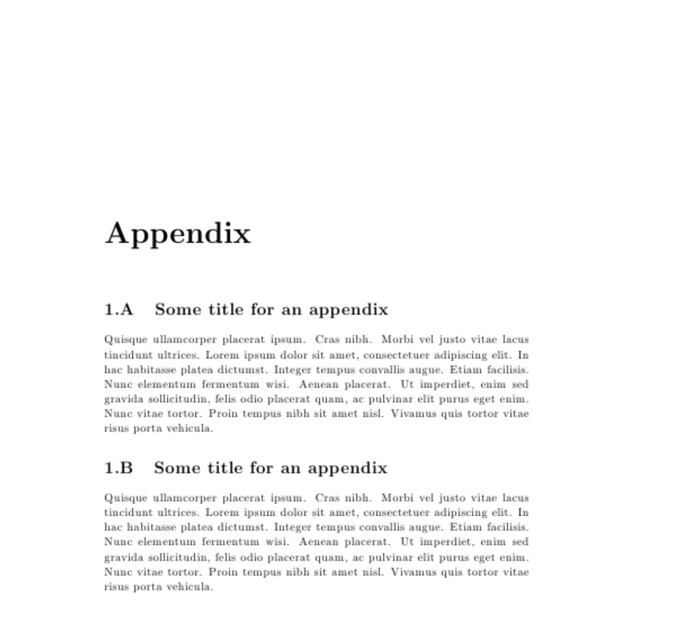

Research Methodology
Structure of Report

Slide 25
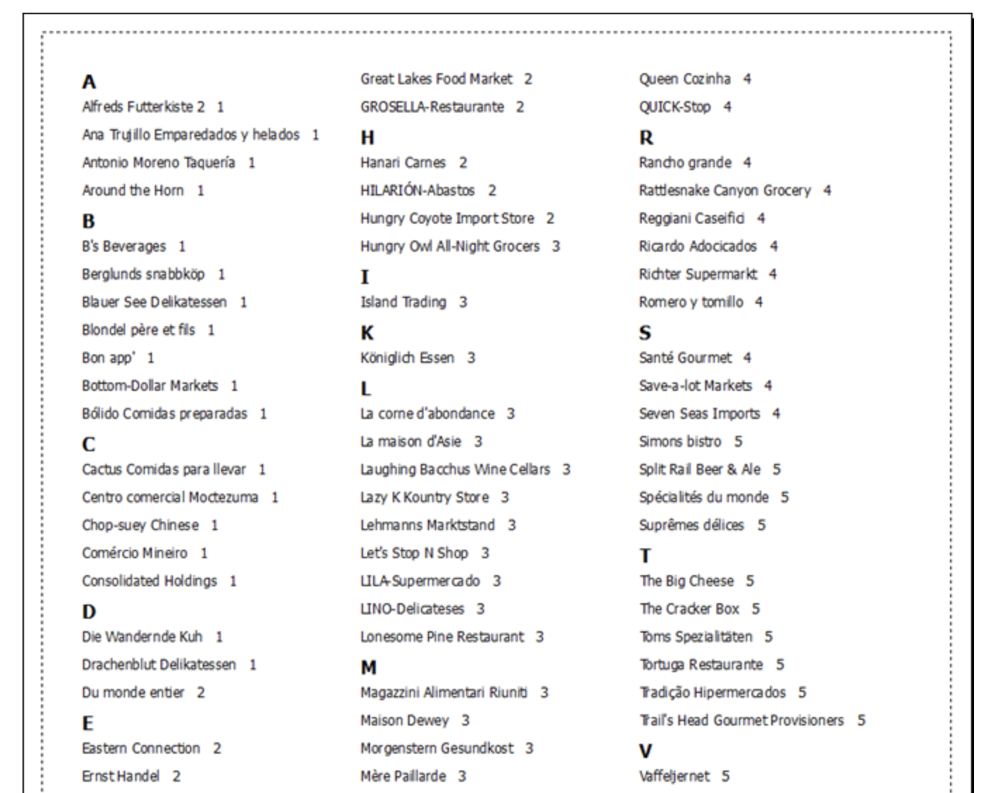

Research Methodology
Structure of Report

Slide 26

Research Methodology
Components of Report
The Main Text includes the following chapters
• Introduction
• Review of Literature
• Methodology
• Research Findings
• Discussion
• Conclusion and Recommendations
• Summary

Slide 27

Research Methodology
Components of Report
Chapter 1: Introduction The introduction is a relatively easy part of the report that can best be written after a first draft of the findings has been made.
It should certainly contain some relevant background data and information about the topic on which you are carrying out research.
You may make additions to the corresponding section in your research proposal, including additional literature, and use it for your report.

Slide 28

Research Methodology
Components of Report
Chapter 1: Introduction
Then, the statement of the problem should follow, again, revised from your Report Writing research proposal with additional comments and relevant literature collected during the implementation of the study.
It should contain a paragraph on what you hope/ hoped to achieve from the results of the study.

Slide 29
Research Methodology
Components of Report
Chapter 2:Review of Literature A literature review is a body of text that aims to review the critical points of current knowledge and or methodological approaches on a particular topic.
Literature reviews are secondary sources, and, as such, do not report any new or original experimental work.
Its ultimate goal is to bring the reader up to date with current literature on a topic, and forms the basis for another goal, such as future research that may be needed in the area.

Slide 30
Research Methodology
Components of Report
Chapter 2:Review of Literature
A well-structured literature review is characterized by a logical flow of ideas; current and relevant references with consistent, appropriate referencing style; proper use of terminology; and an unbiased and comprehensive view of the previous research on the topic.
One research study should be presented in one paragraph and it should mention the name of the researcher, year of study, topic and area of study, sample size, main objectives, and findings of the study.

Slide 31
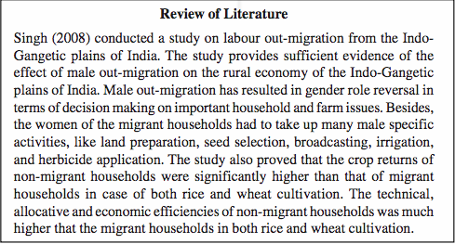
Research Methodology
Components of Report
An example of a review is given in the box below.

Slide 32

Research Methodology
Components of Report
Chapter 3: Methodology The methodology adopted in conducting the study must be fully explained.
The scientific reader would like to know about the basic design of the study, the methods of data collection, information regarding the sample used in the study, the statistical analysis adopted and the factors limiting the study.

Slide 33

Research Methodology
Components of Report
Chapter 3: Methodology
The methodology section should include a description of:
the study type
major study themes or variables (a detailed list of variables on which data was collected may be annexed).
the study/ target population(s), sampling method(s) and the size of the sample(s).
data collection techniques used for the different study populations.

Slide 34
Research Methodology
Components of Report
duration of data collection.
how the data was collected and by whom.
procedures used for data analysis, including statistical tests (if applicable).
any constraints and its management
limitations of the study.

Slide 35
Research Methodology
Components of Report
If you have deviated from the original study design presented in your research proposal, you should explain to what extent you did so, and why.
The consequences of this deviation for meeting certain objectives of your study should be indicated.
If the quality of some of the data is weak, resulting in possible biases, this should be described as well under the heading ‘limitations of the study’.

Slide 36

Research Methodology
Components of Report
Chapter 4: Research Findings A detailed presentation of the findings of the study with supporting data in the form of tables and charts, together with a validation of the results is the next step in writing the main text of the report.
The result section of the study should contain the statistical summaries and reductions of data, rather than raw data. All the results should be presented in a logical sequence and split into readily identifiable sections.

Slide 37

Research Methodology
Components of Report
Chapter 4: Research Findings
The systematic presentation of your findings in relation to the research objectives is the crucial part of your report.
The decision concerning where to put what can best be made after all data have been fully processed and analysed, and before the writing starts.

Slide 38
Research Methodology
Components of Report
When all data have been analysed, a detailed outline has to be made for the presentation of the findings.
This will help the decision-making on how to organise the data, and is an absolute precondition for optimal division of tasks among group members in the writing process.
An outline should contain:
the headings of the main sections of the report.
the headings of subsections.
the points to be made in each section.
the list of tables, figures and/or quotes to illustrate each section.

Slide 39
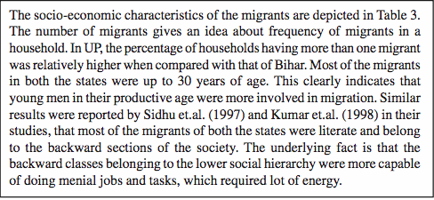

Research Methodology
Components of Report
Chapter 5: Discussion The findings can now be discussed by objective or by cluster of related variables or themes, which should lead to conclusions and possible recommendations.
The discussion may also include findings from other related studies that support or contradict your own.
For easy understanding, the discussion of the table given in findings is given in the box below.

Slide 40

Research Methodology
Components of Report
Chapter 6: Conclusions & Recommendations The conclusions and recommendations should follow logically from the discussion of the findings.
Conclusions can be short, as they have already been elaborately discussed in Chapter 5.
As the discussion will follow the sequence in which the findings have been presented (which in turn depends on your objectives) the conclusions should logically follow the same order.
Sometimes, it is advisable to present conclusion and recommendations in specific sections related to issues of importance/under investigation/objectives of the study for better clarity to different stake holders.
The conclusions should be given in bullets so that it can easily catch the attention of the reader.

Slide 41

Research Methodology
Components of Report
The conclusions should be followed by suggestions or recommendations.
While making recommendations, use not only the findings of your study, but also supportive information from other sources.
The recommendations should be generated from the findings and conclusions.
One should not give general recommendations such as, “Government should provide free treatment to everyone for all health problems”.
If your recommendations are short (roughly one page), you might include them all in your summary and omit them as a separate section in Chapter 6 in order to avoid repetition.

Slide 42

Research Methodology
Components of Report
The references should be given in the following order.
Name of the author, last name first.
Title, underlined to indicate italics.
Place, publisher and date of publication.
Number of volumes.
Example
Kothari, C.R., Quantitative Techniques, New Delhi, Vikas Publishing House Pvt. Ltd., 1978.

Slide 43

Research Methodology
Components of Report
For magazines and newspapers the order may be as follows.
Name of the author, last name first.
Title of the article, in quotation marks.
Name of the periodical, underlined to indicate italics.
The volume and number.
The date of the issue.
The pagination.
Example
Robert V. Roosa, “Coping with Short-term International Money Flows”, The Banker, London, September, 1971, p.995.

Slide 44

Research Methodology
Components of Report
Annexure The annexes should contain any additional information needed to enable professionals to follow your research procedures and data analysis.
Information that would be useful to special categories of readers but is not of interest to the average reader can be included in annexes as well.
Examples of information that can be presented in annexes are:
tables, figures (graphs) and pictures referred to in the text but not included in order to keep the report short.
lists of hospitals, districts, villages, etc., that participated in the study.
questionnaires or check lists used for data collection.
A list of research team members.

Slide 45

Research Methodology
Types of Reports
Research reports vary greatly in length and type. In each individual case, both the length and the form are largely dictated by the problems at hand.
A technical report is used whenever a full written report of the study is required whether for recordkeeping or for public dissemination.
A popular report is used if the research results have policy implications. A popular report emphasises on simplicity and policy implications from the operational point of view, avoiding technical details.

Slide 46
Research Methodology
Types of Reports
(A) Technical Report In the technical report the main emphasis is on:
the methods employed
assumptions made in the course of the study
the detailed presentations of the findings including their limitations and supporting data.

Slide 47
Research Methodology
Types of Reports
A general outline of a technical report can be as follows:
Summary of results: A brief review of the main findings just in two or three pages
Nature of the study: Description of the general objectives of study, formulation of the problem in operational terms, the working hypothesis, the type of analysis and data required etc.
Methods employed: Specific methods used in the study and their limitations. For instance in sampling studies we should give details of sample design viz., sample size, sample selection, etc.
Data: Discussion of data collected, their sources, characteristics and limitations, if secondary data are used, their suitability to the problem at hand be fully assessed. In case of a survey the manner in which data were collected should be fully described.

Slide 48
Research Methodology
Types of Reports
Analysis of data and presentation of findings: The analysis of data and presentation of the findings of the study with supporting data in the form of tables and charts be fully narrated. This in fact happens to be the main body of the report usually extending over several chapters.
Conclusions: A detailed summary of the findings and the policy implications drawn from the results be explained.
Bibliography: Bibliography of various sources consulted be prepared and attached.

Slide 49
Research Methodology
Types of Reports
Technical appendices: Appendices be given for all technical matters relating to questionnaire mathematical derivations, elaboration on particular technique of analysis and the like ones.
Index: Index must be prepared and be given invariably in the report at the end. The presentation may vary in different reports even the different sections outlined above will not always be the same nor will all these sections appear in any particular report.

Slide 50

Research Methodology
Types of Reports
(B) Popular Report The popular report is one which gives emphasis on simplicity and attractiveness, the simplification should be sought through clear writing, minimization of technical, particularly, mathematical, details and liberal use of charts and diagrams.
A general outline of a popular report:
The findings and their implications: Emphasis in the report is given on the findings of most practical interest and on the implications of these findings.
Recommendations for action: Recommendations for action on the basis of the study made, is provided in this section of the report.
Objective of the study: A general review of how the problem arise is presented along with the specific objectives of the project under study.

Slide 51
Research Methodology
Types of Reports
Methods employed: A brief and non-technical description of the methods and techniques used, including a short review of the data on which the study is based, is given in this part of the report.
Results: This section constitutes the main body of the report wherein the results of the study are presented in clear and non-technical terms with liberal use of all sorts of illustrations such as charts, diagrams and the like ones.
(C) Technical appendices: More detailed information on methods used, forms etc., is presented in the form of appendices.
But the appendices are often not detailed if the report is entirely meant for general public.
There can be several variations of the form in which a popular report can be prepared.

Slide 52
Research Methodology
Acknowledgement
Would like to thank Ms. Richa Sharma for preparing these slides.

Slide 53
THANK YOU
Dr. Arti Arya
artiarya@pes.edu

